Slide 1
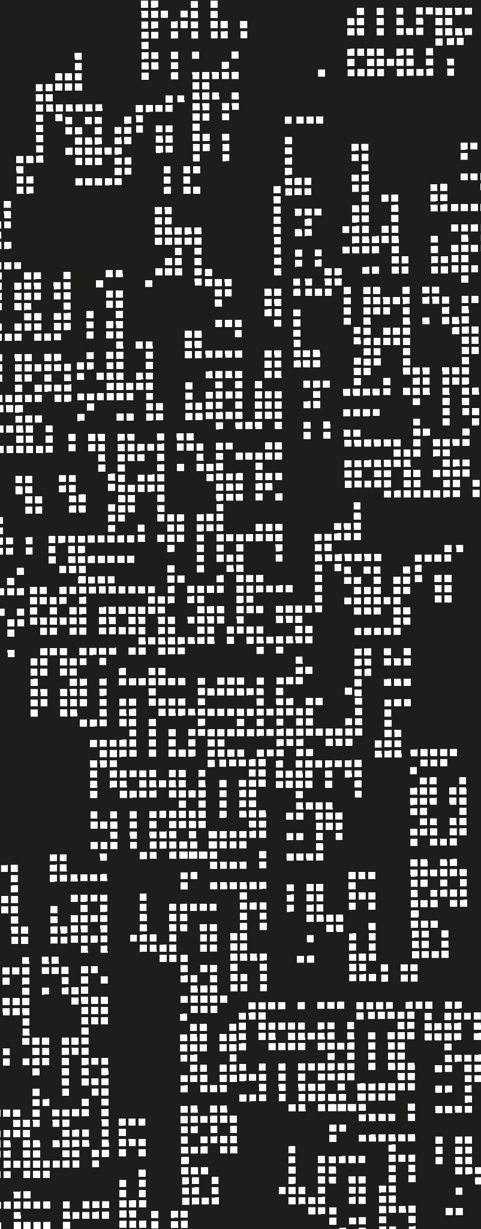
Functional Programming
0. Introduction & Motivation

Slide 2
Contents
01
Course objectives
02
Timeline + Rules
03
Paradigms?
04
Discussion on PL

Slide 3
Why functional programming?
FP is fun (once you know it)
FP is growing (Python, Haskell, JS, Java, etc.)
As good programmers, you need to know you tools (which is wider than a “Hello World!”).
So, what is now the objective of you to take this course?
We wish you to apply this knowledge on resolving problems designing high quality programs using functional programming

Slide 4
Course Contents
Section | Content
Basics | Racket, functions, pattern matching, induction
Substitution + Functions | Substitution, variables, first class and first order functions
Laziness + Recursion | Eager and lazy evaluation, Y operator, tail recursion
Mutation + State | Variable, mutable boxes
Macros + Advanced | Extending programming languages

Slide 5
Evaluation
Section | Points | What to expect?
Basics | 15 | Brain Test, 1 Practice
Substitution + Functions | 35 | Brain Test, 2 Practices, 1 Presentation
Laziness + Recursion | 15 | Brain Test, 1 Practice
Mutation + State | 15 | Brain Test, 1 Practice
Macros + Advanced | 10 | Brain Test

Slide 6
Evaluation
Participation + Assistance = 10 points.
However, you must earn them. Each class your assistance will be registered by your written answer to a question sent to the teacher.
If there is a heavy task that you fulfill during the class, there will be extra points.
Your final exam is a project
(Presentation + Defense)

Slide 7

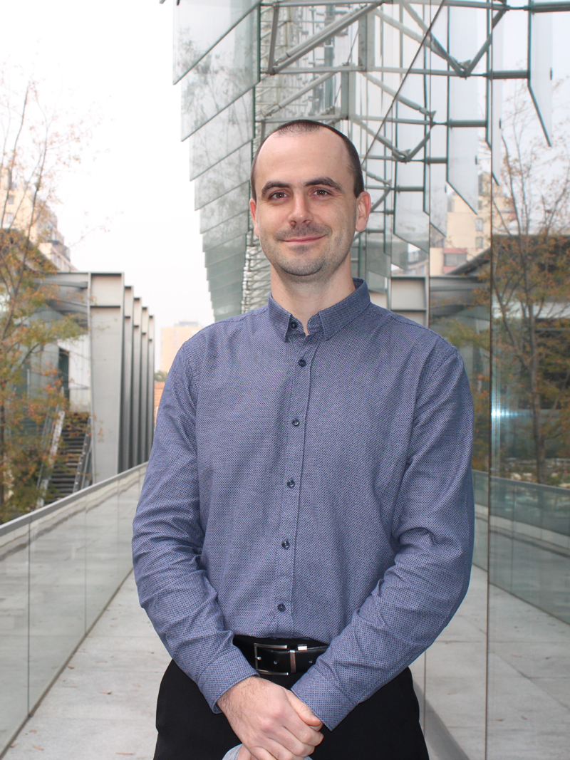
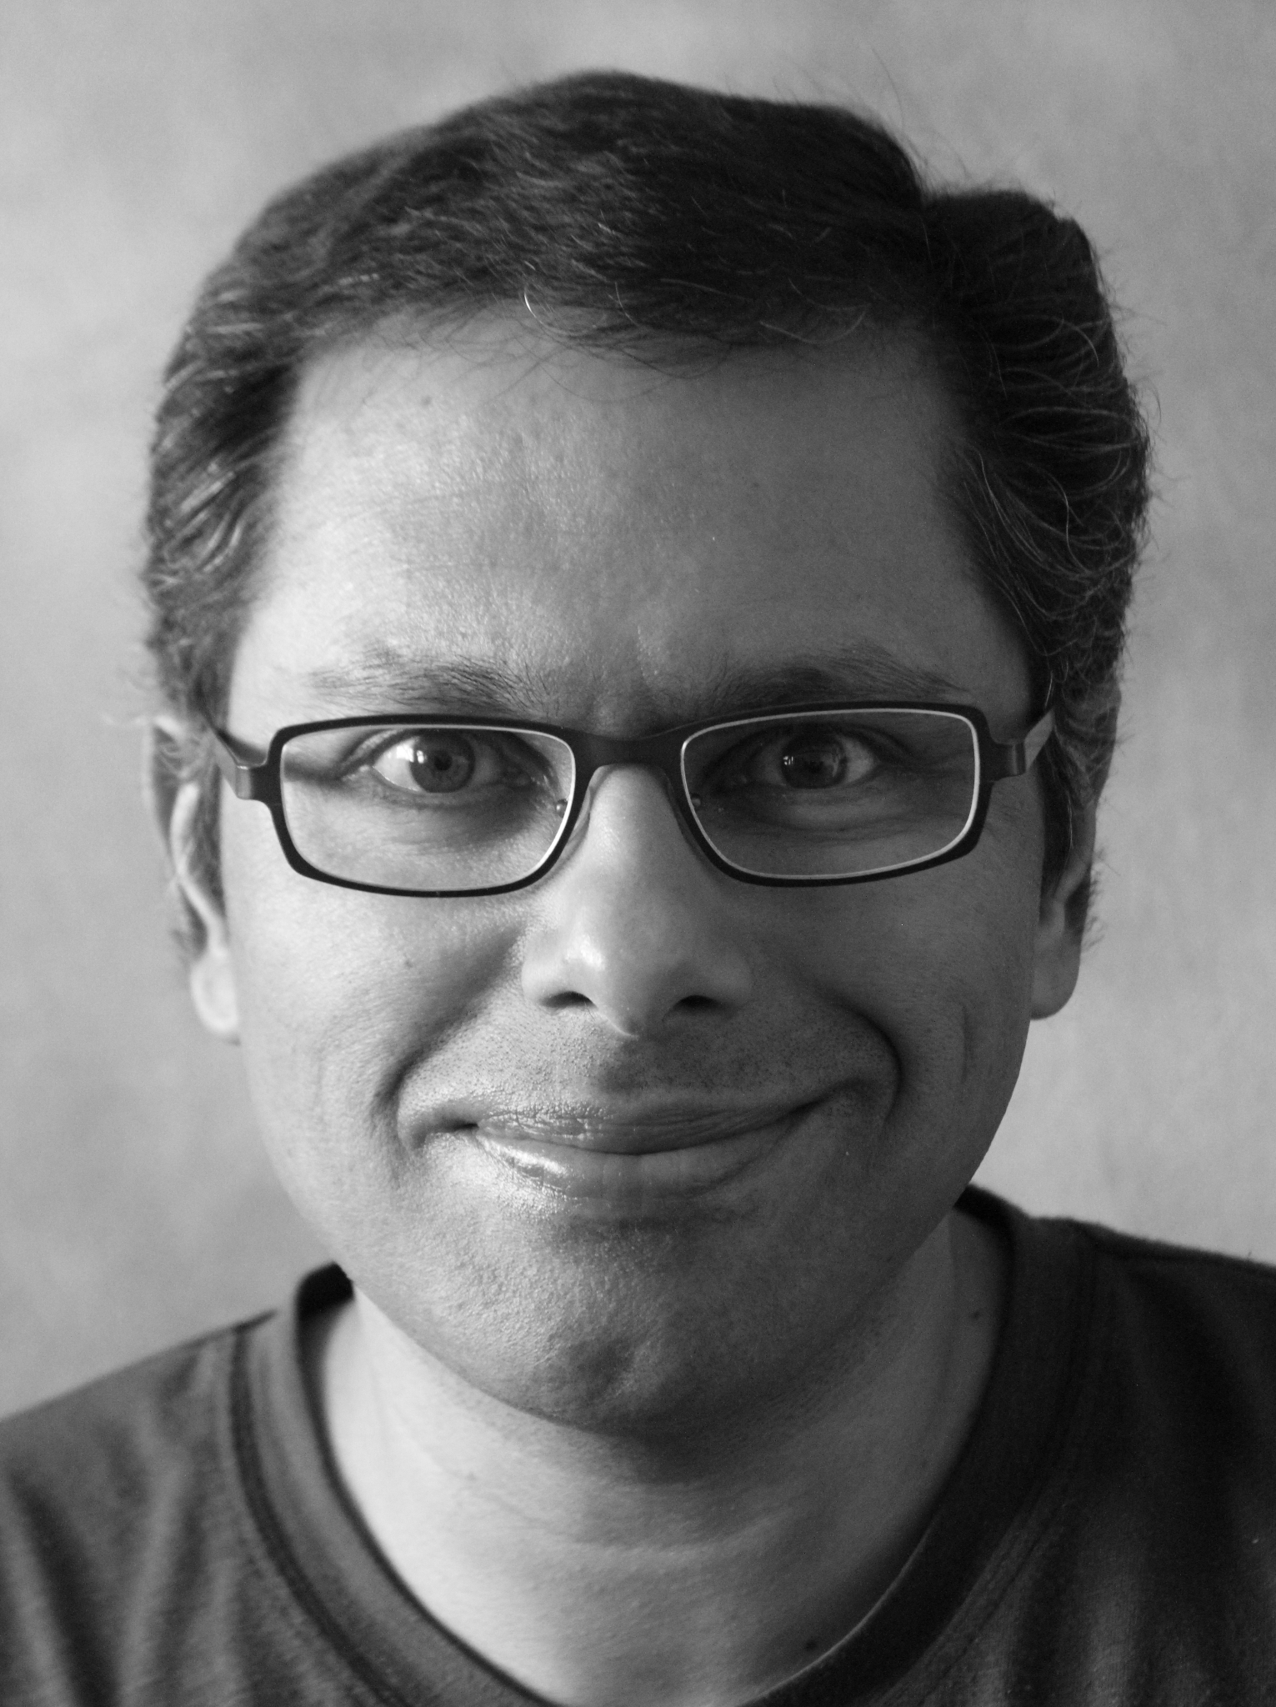

Course Basis

Slide 8
Course Bibliography
PrePLAI (E.Tanter) (https://users.dcc.uchile.cl/~etanter/preplai/index.html)
Programming Languages: Application and Interpretation (S. Krishnamurthi) (https://pleiad.cl/_media/teaching/cc4101/plai-2007-04-26.pdf)
Other references
Grokking Simplicity: Taming Complex Software with Functional Thinking (E. Normand)
Essentials of Programming Languages (D. Friedman, M. Wand, C. Haynes)
The Little Schemer (D. Friedman, M. Felleisen)

Slide 9
Rules
Arrive on time (you may write the teacher if there is a heavy reason you’ll be late).
Pay attention, if not, do not distract the others.

Slide 10
Rules
There is no extra homework at the end of the semester.
Todas las entregas son individuales. Toda entrega deber ser enteramente fruto de su trabajo y no puede ser derivada del trabajo de otros, ya sea de fuentes publicadas como no publicadas, la web, otro estudiante, libros, materia de otros cursos (incluyendo semestres anteriores de este curso), o cualquier otra persona o programa. Se prohíbe copiar o alterar la tarea de otra persona, o usar un programa para transcribir, modificar o copiar los archivos de otro alumno.
Si se conversa de una solución con otro estudiante, todas las partes deberán reportar a los participantes de la discusión.
Toda violación será reportada a las autoridades de la carrera, solicitando un sumario

Slide 11

GPT Policy
Ok, you are allowed to use Chat GPT (teacher is no omniscient to see if you copy an answer for it).
But, for your own good, if you are using this tool, understand the answers it gives you, do not just copy and paste the solution, understand the process. And for ethics, cite it.
In the end, you knowledge will be tested and is better for you to understand what you are doing.

Slide 12
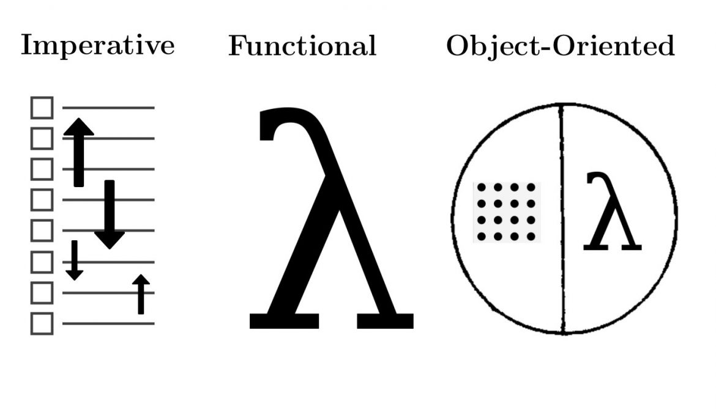
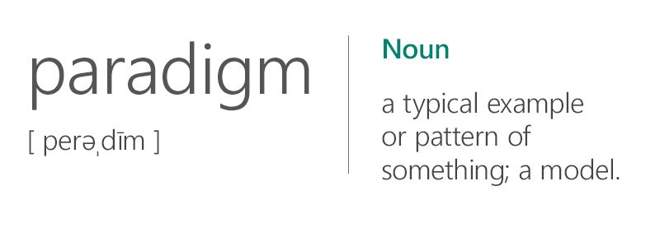
Paradigms

Slide 13
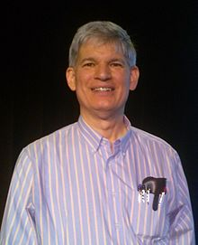
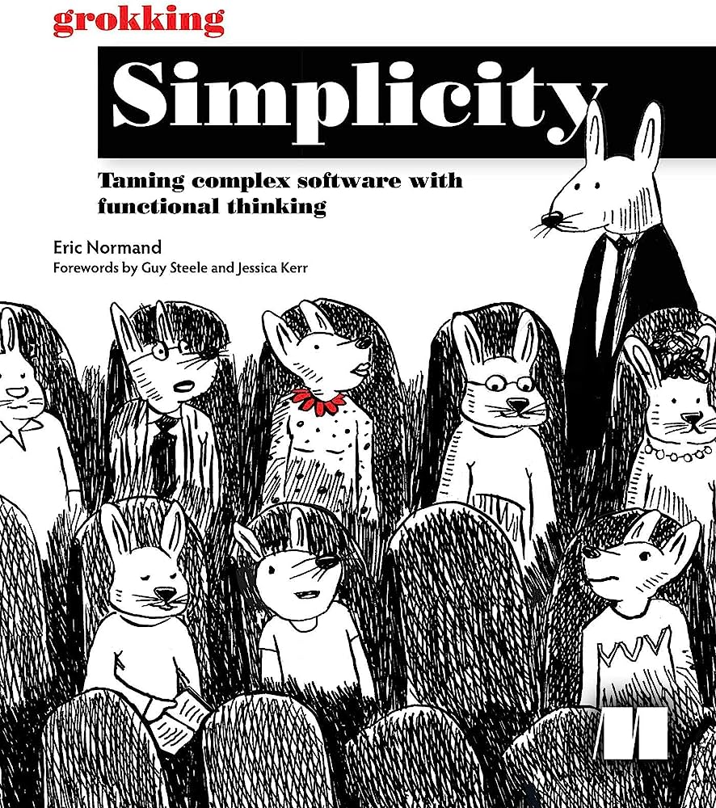
Paradigms
Guy L. Steele Jr.
MIT PhD in Computer Science.
Co-Author of the Lambda Papers
Expert on LISP, C, Java, etc, etc.
Creator of SCHEME
Editor of the first editions of ECMAScript
Songwriter for ACM.

Slide 14
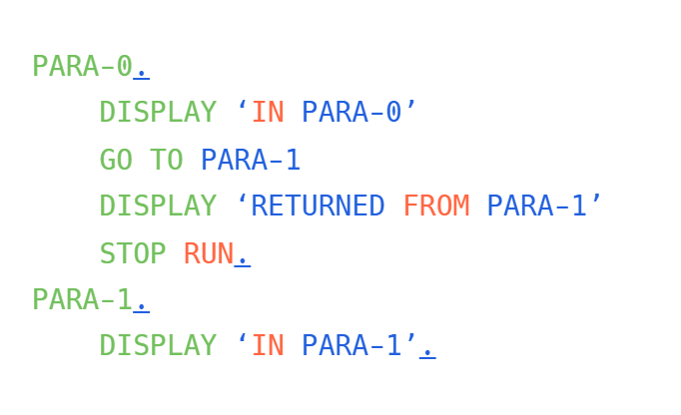
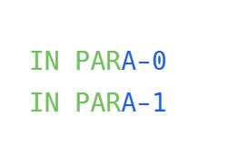
1960’s - Unstructured Programming
COBOL example

Slide 15
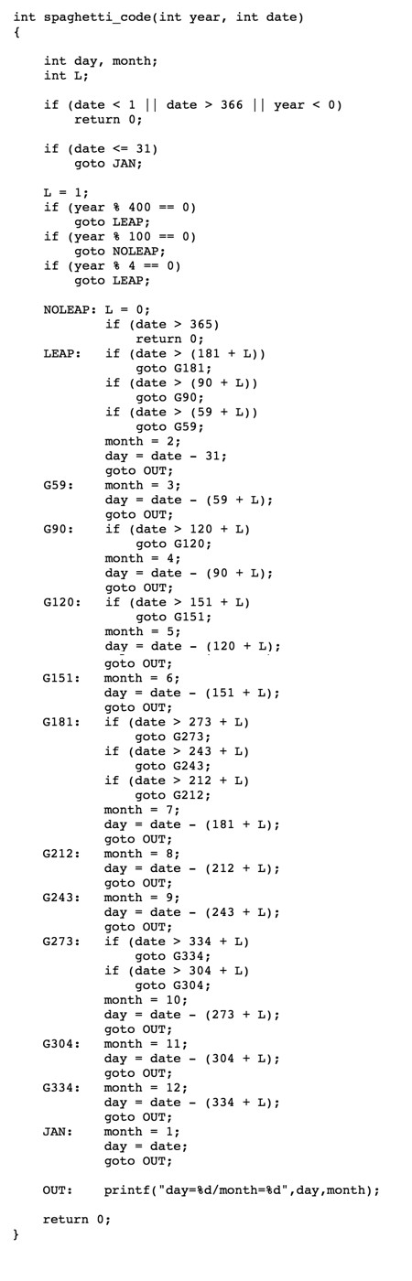
1960’s - Unstructured Programming

Slide 16
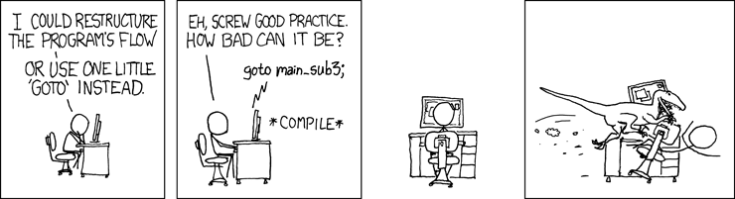
1960’s - Unstructured Programming

Slide 17
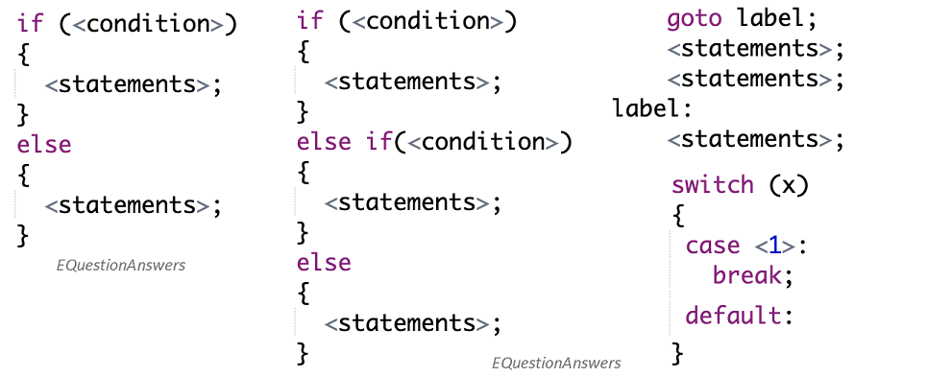
1970’s - Structured Programming
Two main ideas: ORGANIZING CONTROL FLOW
Most control flow could be expressed in terms of a few simple patterns: if-else, switch, while and for loops. (No goto statements)
Sequential statements could be grouped into blocks that should be properly nested
PATTERNS are IMPORTANT

Slide 18
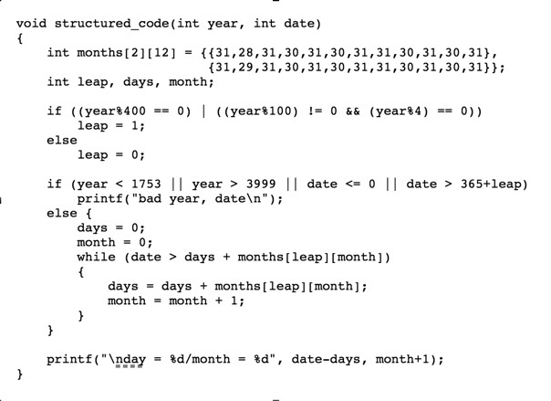
1960’s - Unstructured Programming

Slide 19
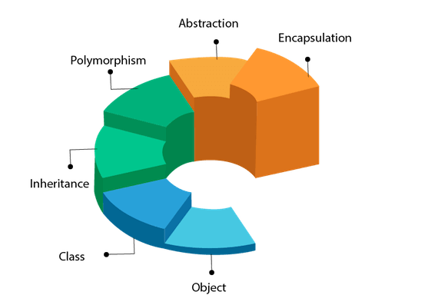
1980’s - Object-Oriented Programming
Two main ideas: ORGANIZING ACCESS TO DATA
Variables should be encapsulated or contained in some way. Consistency properties, limit access.
Inheritance, complex objects extend simpler ones.

Slide 20
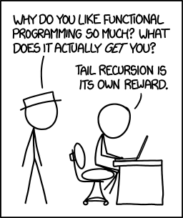
1980’s - Functional Programming (since 30s)
Two main ideas: ORGANIZING SIDE EFFECTS
Distinguishing between computations (things that produce the same result) from actions (that to have side effects on the outside world)
Set of techniques for processing collections of data, arrays, lists, databases, all at once.

Slide 21
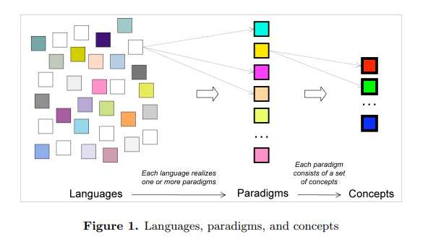
From: Programming Paradigms for Dummies: What Every Programmer Should Know - Peter van Roy

Slide 22
Programming Languages
Your experience:
What PLs have you used?
Which PLs’ features do you like/dislike? Why?

Slide 23
Programming Languages
A: 50 entries (Ada, ALGOL)
B: 16 entries (BASIC, B)
C: 68 entries (C Family)
D: 18 entries (Dart, Delphi)
E: 30 entries (Erlang)
F: 28 entries (F, Fortran)
G: 26 entries (Go, Groovy)
H: 20 entries (Haskell, Hop)
I: 10 entries (IBM assembly)
J: 25 entries (Java, JS)
K: 16 entries (Kotlin)
L: 35 entries (LISP)
M: 51 entries (MATLAB)
N: 23 entries (NetLogo)
O: 30 entries (Objective-C)
P: 63 entries (Python, Pascal)
Q: 8 entries (QuakeC)
R: 24 entries (R, Ruby)
S: 71 entries (Scheme, Smalltalk)
T: 27 entries (TeX, TypeScript)
U: 7 entries (UnrealScript)
V: 11 entries (Visual Prolog, Vim)
W: 7 entries (WebAssembly)
X: 17 entries (XQuery)
Y: 3 entries (YQL)
Z: 9 entries (Zig)
List of programming languages - Wikipedia

Slide 24
Programming Languages
In general:
What is a PL?
Why are new PLs created? Why are there so many?

Slide 25
Programming Languages
In theory …
All languages are equivalent:
They are all Turing-complete which means they can compute the same things

Slide 26
Programming Languages
Pragmatically …
Do the same things is not all that matters
A PL needs more things. e.g.

Slide 27
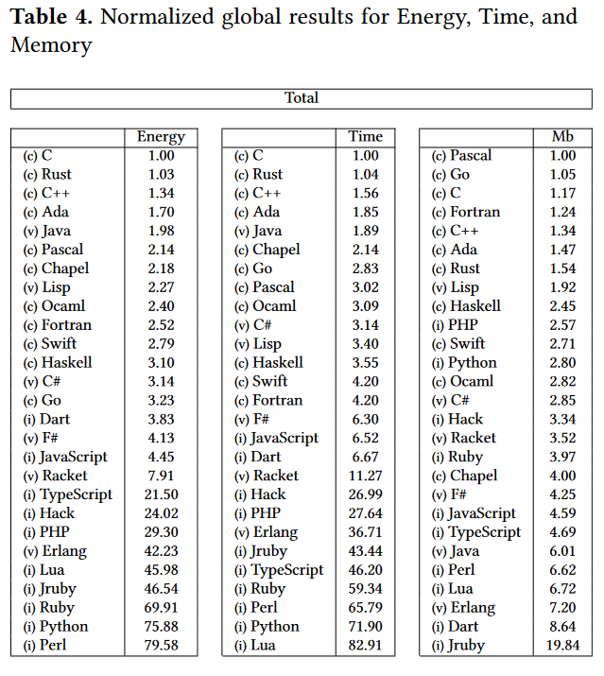
Efficiency
Energy Efficiency Across Programming Languages. How does energy, time and memory relate?
R. Pereira, M. Couto et al.
https://greenlab.di.uminho.pt/wp-content/uploads/2017/09/paperSLE.pdf

Slide 28
Communicative, Pleasant to write, manageable
++++++++++[>+++++++>++++++++++>+++<<<-]>++.>+.+++++++
..+++.>++.<<+++++++++++++++.>.+++.------.--------.>+.
(=<`#9]~6ZY327Uv4-QsqpMn&+Ij"'E%e{Ab~w=_:]Kw%o44Uqp0/Q?xNvL:`H%c#DD2^WV>gY;dts76qKJImZkj
cout << “Hello world” << endl;
System.out.println(“Hello world”);

Slide 29
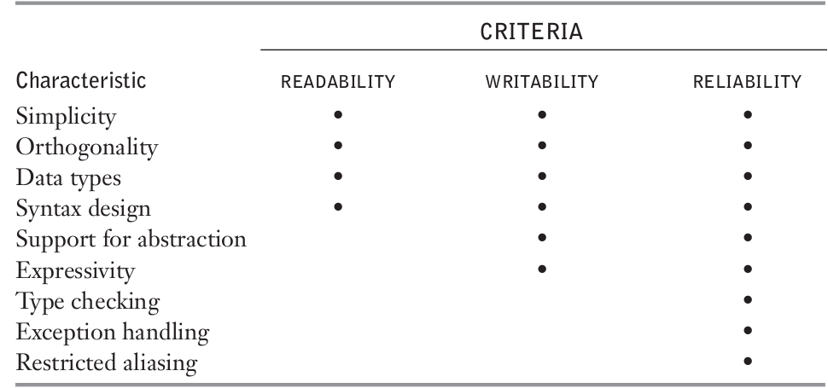
Reliability
Concepts of Programming Languages (R. Sebesta) http://www.sci.brooklyn.cuny.edu/~chuang/books/sebesta.pdf

Slide 30
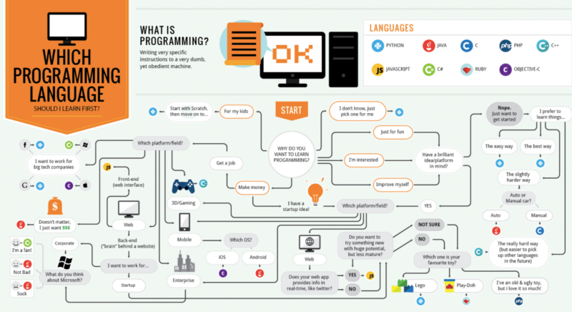
Programming Languages
Why to study PLs?
Different problems require different languages

Slide 31
Programming Languages
So, the best thing you can do is:
Know your tools
Choose the right one for the right task
Use tools effectively

Slide 32
What defines a PL?
Syntax
What sequence of symbols define a valid program?
The FORM of programs
Semantics
How does a program behave? What actions does it perform? What values does it produce?
The MEANING of programs

Slide 33
Why not to focus only on syntax?
Three ways of expressing: “retrieve the i-th element of array x” in different programming languages
x[i] C
(vector-ref x i) Scheme
X[i] Java

Slide 34
Why not to focus only on syntax?
Although the three looked similar, these expressions mean different things
Therefore:
Do not get too emotional about the syntax
Do not fall in love with the syntax

Slide 35
Why not to focus only on syntax?
Do not get too emotional about the syntax
Do not fall in love with the syntax
3 + 4 infix notation
(+ 3 4) prefix notation
(3 4 +) postfix notation

Slide 36
Just semantics. That’s all there is.
Shriram Krishnamurthi

Slide 37
But, how do we describe semantics?
Natural language is not well-suited, it is too imprecise!!
Mathematic is an option:
Denotational: Mathematical meaning to each program
Axiomatic: Logical relationship between the properties before and after the execution
Operational: Sequence of computational steps
So, we can use an “in-between” approach
Interpreter: The interpreter executes the program (step by step) and returns its output

Slide 38
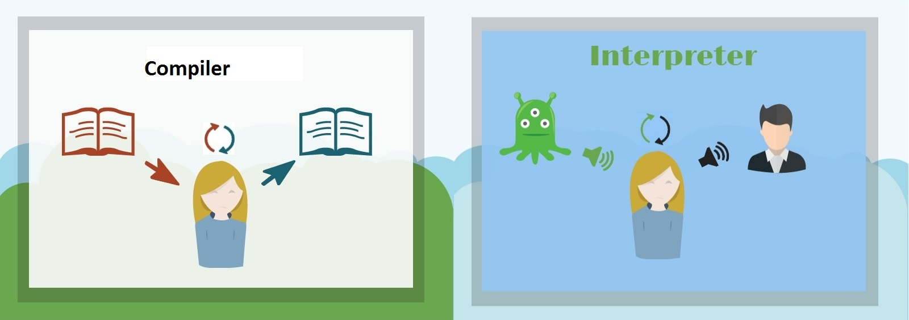
How does an interpreter works?
To explain a language, write an interpreter for it!
Writing forces understanding
Allows executions and incremental modifications
However, you write an interpreter as a program in a PL
Use a simple language with mathematical foundations

Slide 39

Scheme
LISP dialect, developed in 1975 - 1980 (MIT AI Lab)
Functional programming language
Small core + powerful extension tools
https://racket-lang.org

Slide 40
Summary
Semantics is the most important component of a PL
Understanding the different mechanisms of PLs + semantics is fundamental for using effectively.

Slide 41
On next class
Basic Guide for Racket Language
Primitives + Data Structures

